Slide 1
Exception Handling

Slide 2
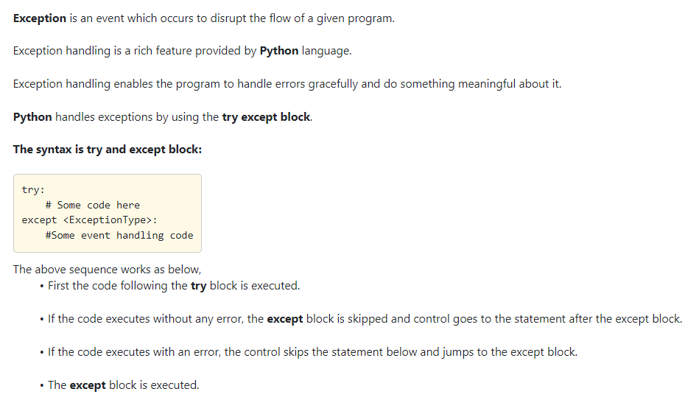

Slide 3
Which of the following is/ or are correct options?
Exception is an event which occurs to disrupt the flow of the given program.
Exception handling is a rich feature provided by Python language.
Python handles exceptions by using the try catch block.
If the code executes without any error, the except block is skipped and control goes to the statement after the except block.

Slide 4
Which of the following is/ or are correct options?
Exception is an event which occurs to disrupt the flow of the given program.
Exception handling is a rich feature provided by Python language.
Python handles exceptions by using the try catch block.
If the code executes without any error, the except block is skipped and control goes to the statement after the except block.

Slide 5
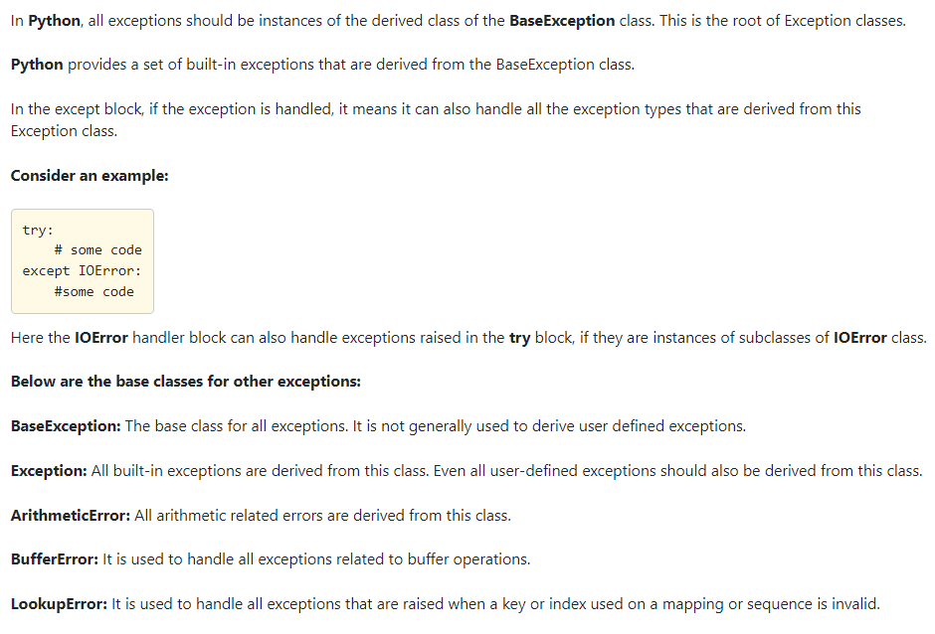

Slide 6
Which of the following is/ or are correct options?
All exceptions should be instances of the derived class of the BaseException class.
In the except block, if the exception is handled, it means it can also handle all the exception types that are derived from this Exception class.
BaseException is generally used to derive user defined exceptions.
All built-in exceptions are derived from the Exception class.

Slide 7
Which of the following is/ or are correct options?
All exceptions should be instances of the derived class of the BaseException class.
In the except block, if the exception is handled, it means it can also handle all the exception types that are derived from this Exception class.
BaseException is generally used to derive user defined exceptions.
All built-in exceptions are derived from the Exception class.

Slide 8
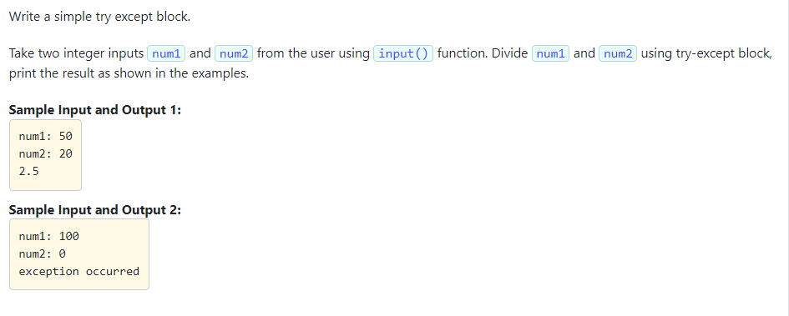

Slide 9
Solution:
num1 = int(input("num1: "))
num2 = int(input("num2: "))
try:
num3 = num1 / num2
print(num3)
except:
print("exception occurred")

Slide 10
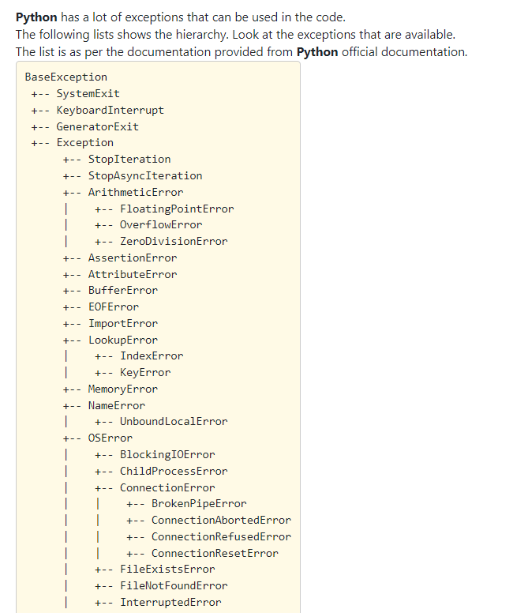
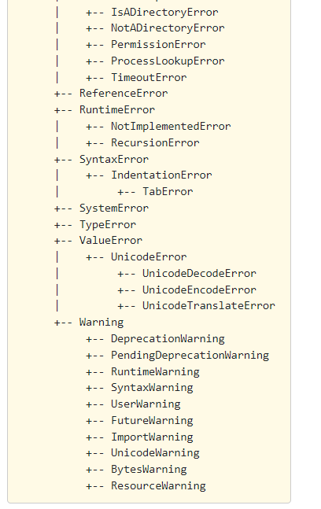

Slide 11
Which of the following is/ or are the correct options?
The root exception class is the BaseException.
SystemExit, KeyboardInterrupt, GeneratorExit and Exception extend from the BaseException.
The Rest of the built-in classes are derived from the Exception class.

Slide 12
Which of the following is/ or are the correct options?
The root exception class is the BaseException.
SystemExit, KeyboardInterrupt, GeneratorExit and Exception extend from the BaseException.
The Rest of the built-in classes are derived from the Exception class.
All are correct

Slide 13
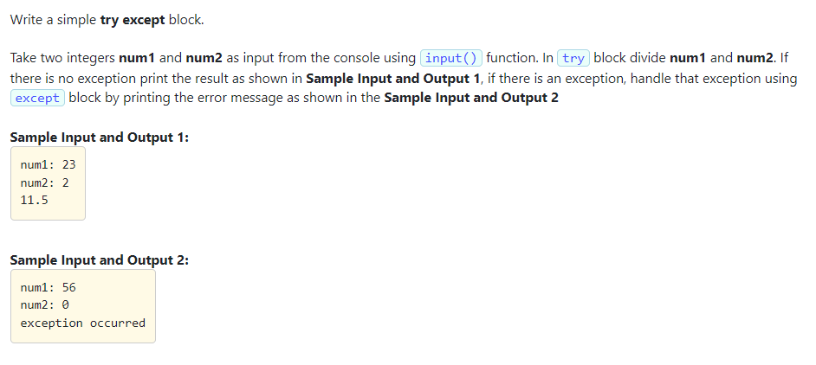

Slide 14
Solution:
num1 = int(input("num1: "))
num2 = int(input("num2: "))
try:
num3 = num1 / num2
print(num3)
except:
print("exception occurred")

Slide 15
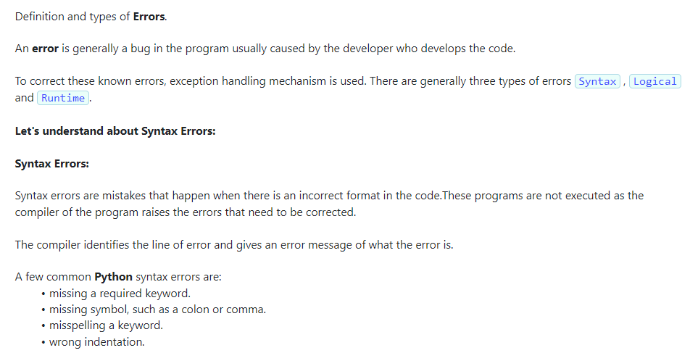

Slide 16
Which of the following is/ or the correct option?
A error is generally a bug in the program usually caused by the developer who develops the code.
There are generally three types of errors.
Syntax errors are mistakes that happen if the programs that are written do not use the correct format of the language.
Syntax Errors are the most difficult to be corrected.

Slide 17
Which of the following is/ or the correct option?
A error is generally a bug in the program usually caused by the developer who develops the code.
There are generally three types of errors.
Syntax errors are mistakes that happen if the programs that are written do not use the correct format of the language.
Syntax Errors are the most difficult to be corrected.

Slide 18
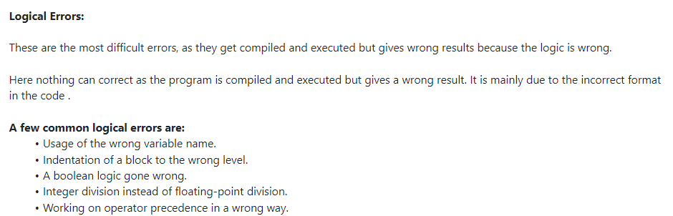

Slide 19
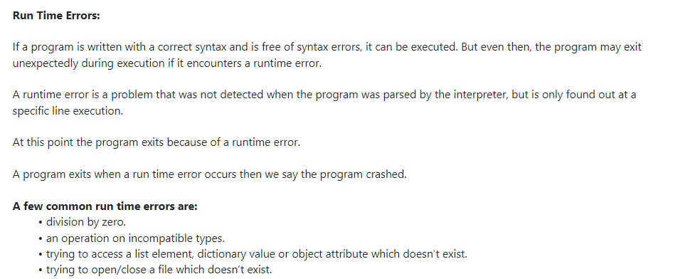

Slide 20
Which of the following is/ or the correct option?
A program may exit unexpectedly during execution if it encounters a runtime error.
A runtime error is a problem that was not detected when the program was parsed by the interpreter, but is only found out at a specific line execution.
When a program exits when a run time error occurs, we say the program crashed.
Division by zero is not a logical error.

Slide 21
Which of the following is/ or the correct option?
A program may exit unexpectedly during execution if it encounters a runtime error.
A runtime error is a problem that was not detected when the program was parsed by the interpreter, but is only found out at a specific line execution.
When a program exits when a run time error occurs, we say the program crashed.
Division by zero is not a logical error.
All options are correct!!

Slide 22
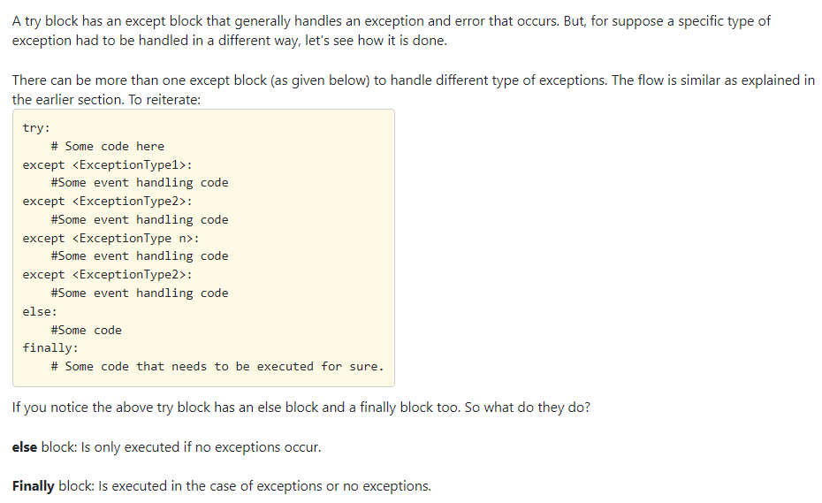

Slide 23
Which of the following is/ or the correct option?
A try block can have more than one except block, each block handling a type of Exception.
Based on the Exception/error that has been generated, the except block that is written to handle that exception is invoked.
A try block can have an else block or finally block, only either one of them.
Finally block is executed in the case of exceptions or no exceptions.

Slide 24
Which of the following is/ or the correct option?
A try block can have more than one except block, each block handling a type of Exception.
Based on the Exception/error that has been generated, the except block that is written to handle that exception is invoked.
A try block can have an else block or finally block, only either one of them.
Finally block is executed in the case of exceptions or no exceptions.

Slide 25
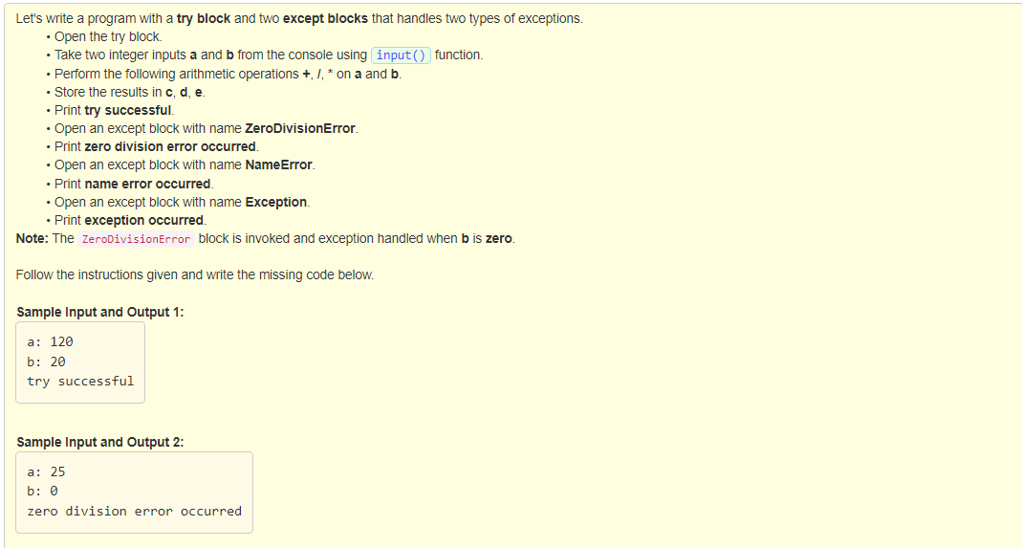

Slide 26
try:
a = int(input("a: "))
b = int(input("b: "))
c = a + b
d = a / b
e = a * b
if a == 0:
f = fun1(a)
print("try successful")
except ZeroDivisionError:
print("zero division error occurred")
except NameError:
print("name error occurred")
except Exception:
print("exception occurred")
def fun1(n):
print(n)

Slide 27
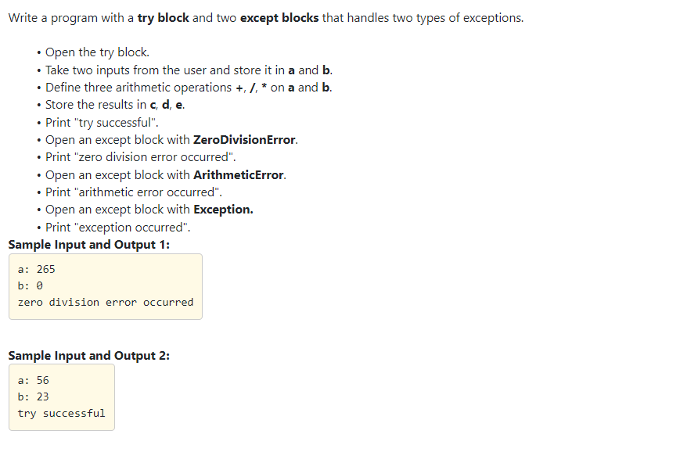

Slide 28
try:
a = int(input("a: "))
b = int(input("b: "))
c = a + b
d = a / b
e = a * b
print("try successful")
except ZeroDivisionError:
print("zero division error occurred")
except ArithmeticError:
print("arithmetic error occurred")
except Exception:
print("exception occurred")

Slide 29
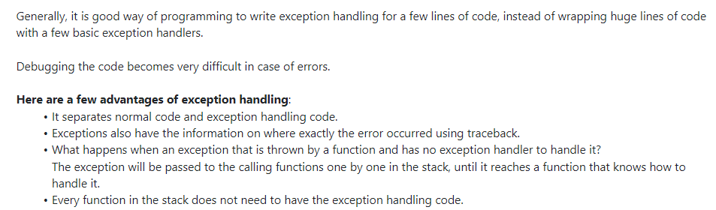

Slide 30
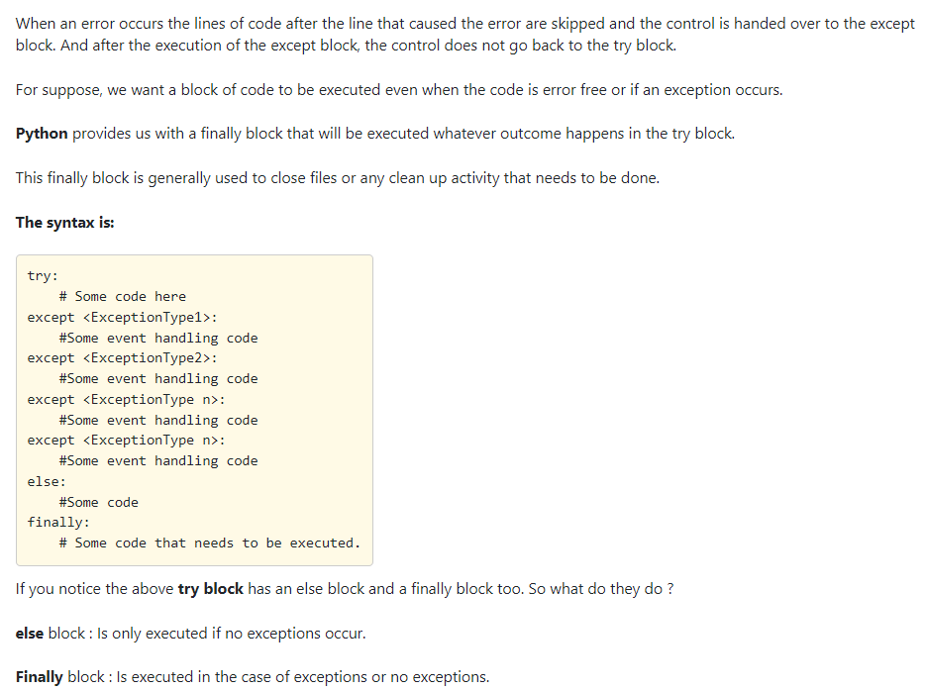

Slide 31
Correct options?
finally block will be executed whatever the outcome that happens in the try block.
finally block is written after all the except blocks.
finally block is executed in only in the case of exceptions.

Slide 32
Correct options?
finally block will be executed whatever the outcome that happens in the try block.
finally block is written after all the except blocks.
finally block is executed in only in the case of exceptions.

Slide 33
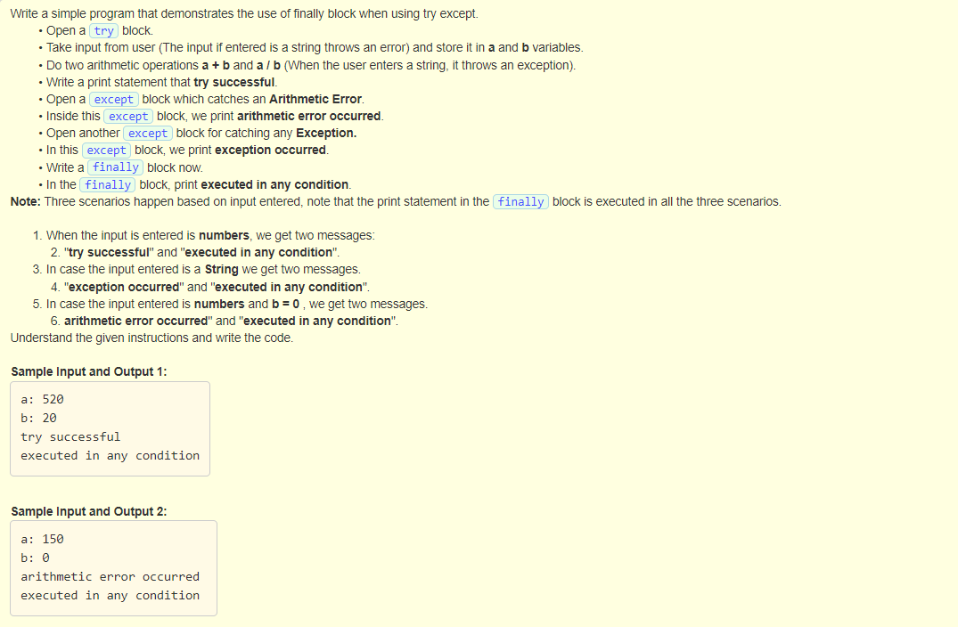
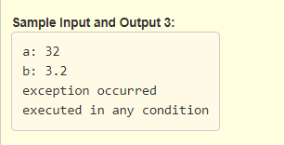

Slide 34
try:
a = int(input("a: "))
b = int(input("b: "))
c = a + b
e = a / b
print("try successful")
except ArithmeticError:
print("arithmetic error occurred ")
except Exception:
print("exception occurred")
finally:
print("executed in any condition")

Slide 35
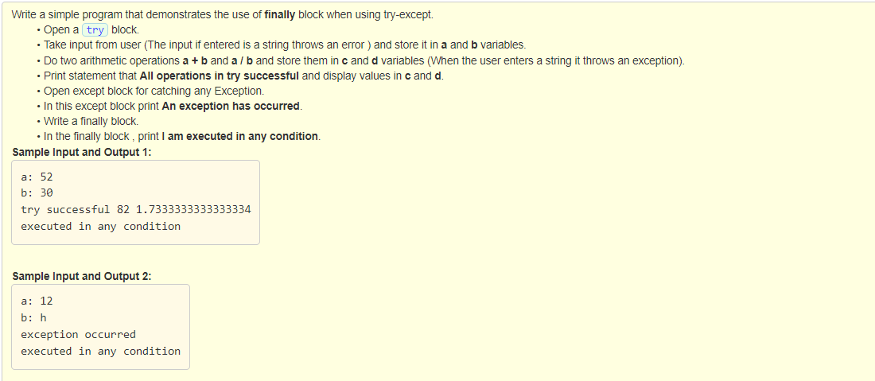

Slide 36
try:
a = int(input("a: "))
b = int(input("b: "))
c = a + b
d = a / b
print("try successful", c , d)
except Exception:
print("exception occurred")
finally:
print("executed in any condition")

Slide 37
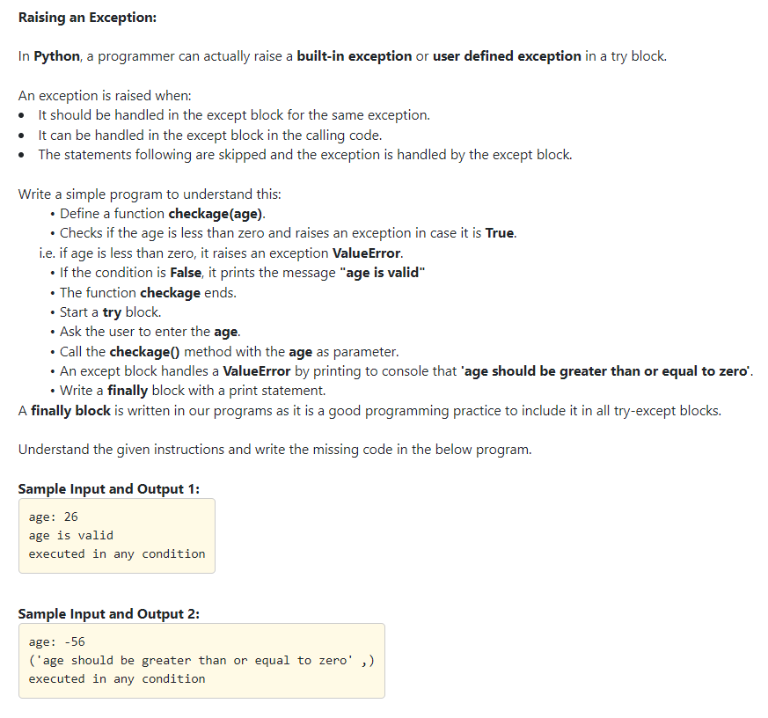

Slide 38
def checkage(age):
if age < 0:
raise ValueError("age should be greater than or equal to zero")
print("age is valid")
try:
age = int(input("age: "))
checkage(age)
except ValueError as err:
print(err.args)
finally:
print("executed in any condition")

Slide 39
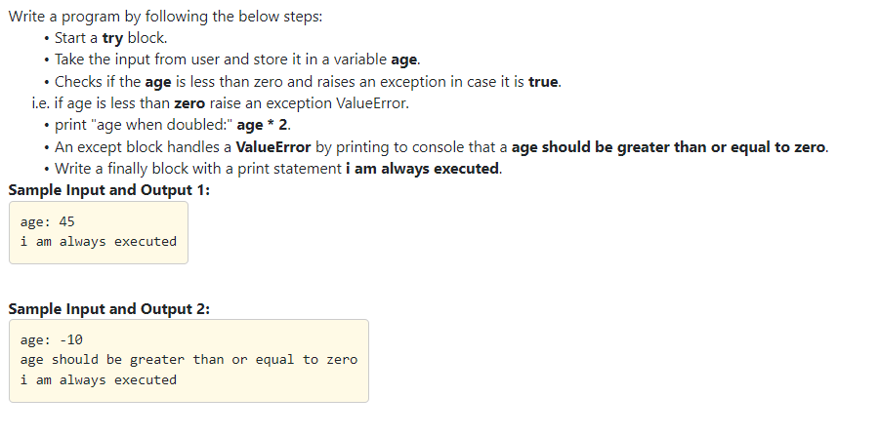

Slide 40
try:
age = int(input("age: "))
if(age < 0):
raise ValueError("age should be greater than or equal to zero")
print("age when doubled:", age * 2)
except ValueError as err:
print("age should be greater than or equal to zero")
finally:
print("i am always executed")

Slide 41
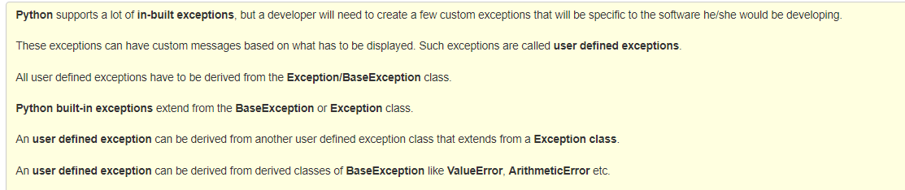

Slide 42
Correct options?
Python supports a lot of in-built exceptions.
All user defined exceptions have to be derived from the Exception class.
Python built-in exceptions extend from the BaseException/Exception class.
An user defined exception cannot be derived from another user defined exception class that extends from a Exception class.

Slide 43
Correct options?
Python supports a lot of in-built exceptions.
All user defined exceptions have to be derived from the Exception class.
Python built-in exceptions extend from the BaseException/Exception class.
An user defined exception cannot be derived from another user defined exception class that extends from a Exception class.

Slide 44
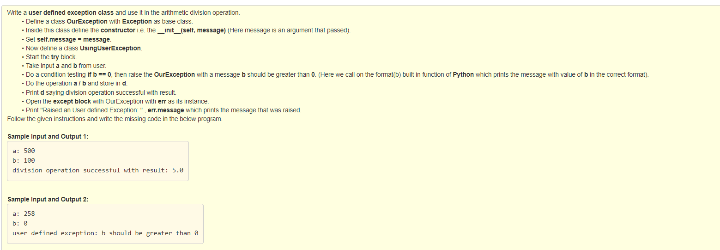

Slide 45
class OurException(Exception):
def __init__(self, message):
self.message = message
class UsingUserException:
try:
a = int(input("a: "))
b = int(input("b: "))
if b == 0:
raise OurException("b should be greater than 0")
d = a / b
print("division operation successful with result:", d)
except OurException as err:
print("user defined exception:", err.message)

Slide 46
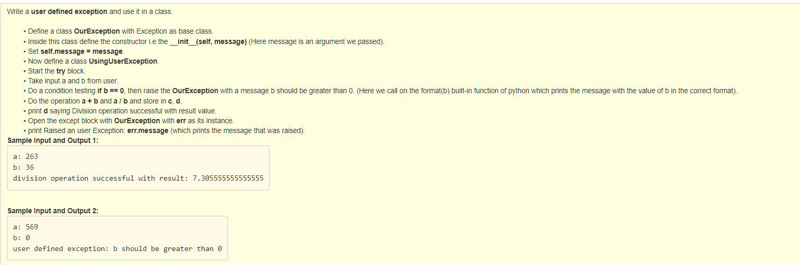

Slide 47
class OurException(Exception):
def __init__(self, message):
self.message = message
class UsingUserException:
try:
a = int(input("a: "))
b = int(input("b: "))
if b == 0:
raise OurException("b should be greater than 0")
d = a / b
print("division operation successful with result:", d)
except OurException as err:
print("user defined exception:", err.message)

Slide 48
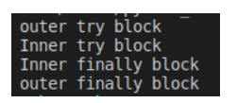
Nested try examples
try:
print("outer try block")
try:
print("Inner try block")
except ZeroDivisionError:
print("Inner except block")
finally:
print("Inner finally block")
except:
print("outer except block")
finally:
print("outer finally block")

Slide 49

try:
print("outer try block")
print(10/0)
try:
print("Inner try block")
except ZeroDivisionError:
print("Inner except block")
finally:
print("Inner finally block")
except:
print("outer except block")
finally:
print("outer finally block")

Slide 50
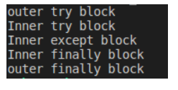
try:
print("outer try block")
try:
print("Inner try block")
print(10/0)
except ZeroDivisionError:
print("Inner except block")
finally:
print("Inner finally block")
except:
print("outer except block")
finally:
print("outer finally block")

Slide 51
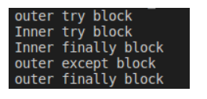
try:
print("outer try block")
try:
print("Inner try block")
print(10/0)
except NameError:
print("Inner except block")
finally:
print("Inner finally block")
except:
print("outer except block")
finally:
print("outer finally block")

